Slide 1


SAP UI5 & FIORI with OData TRAINING
Anubhav Oberoy & Nishan Nainsukha
Day – 4

Slide 2

Agenda – Day 4
Variables and datatypes
Concept of functions in JavaScript
Functions with parameters
Functions with multiple parameters
Understanding the concept of Array & Object
Concept of JavaScript Object Notations (JSON)
---jQuery--
Introduction to jQuery
Concept of write less and do more in jQuery
Understanding the syntax of jQuery
Understanding the concept of Content Delivery Network (CDN)

Slide 3
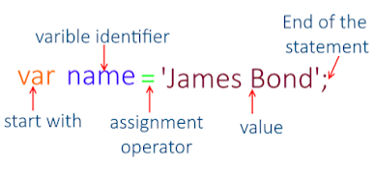
Variables in JS
Variables are containers for storing data (values).
All JavaScript variables must be identified with unique names
These unique names are called identifiers.
JavaScript identifiers are case-sensitive.
JavaScript Variables
var
let
const
Variable stores data value that can be changed later on.
var x = 5;
var y = 10;
var z = x + y;
let is a keyword that is used to declare a block scoped variable.
let hello = ‘Hello world’;
let message;
Message = hello;
To declare a constant (unchanging) variable, use const.
const color = "#F00";
Trainer: Anubhav Oberoy

Slide 4
Datatypes in JS
Data types describe the different types or kinds of data that we're gonna be working with and storing in variables. In Javascript, there are five basic, or primitive, types of data. The five most basic types of data are strings, numbers, Booleans, undefined, and null. We refer to these as primitive data types.
Boolean
01
Null
02
Boolean represents a logical entity and can have two values: true and false.
The null type has exactly one value: null.
Undefined
03
07
Number
undefined variable that has not been assigned a value has the value undefined.
Numbers can be written with or without decimals.
BigInt
06
Symbol
04
05
String
The BigInt type is a numeric primitive in JavaScript that can represent integers with arbitrary precision.
Symbol is unique and immutable primitive value and may be used as the key of an Object Property
JavaScript's String type is used to represent textual data.
Trainer: Anubhav Oberoy

Slide 5
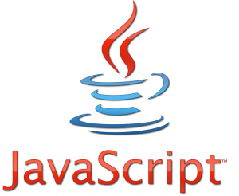
Concept of functions in JS
A function in JavaScript is similar to a procedure—a set of statements that performs a task or calculates a value, but for a procedure to qualify as a function, it should take some input and return an output where there is some obvious relationship between the input and the output.
A JavaScript function is defined with the function keyword, followed by a name, followed by parentheses ().
Function names can contain letters, digits, underscores, and dollar signs (same rules as variables).
A JavaScript function is a block of code designed to perform a particular task
Function parameters are listed inside the parentheses () in the function definition.
Function arguments are the values received by the function when it is invoked.
Inside the function, the arguments (the parameters) behave as local variables.
Function without parameters
function myFirstDemoFunction(){
alert('welcome to inline js’);
}
Trainer: Anubhav Oberoy

Slide 6

Functions with parameters
Function parameters are the names listed in the function definition.
Function arguments are the real values passed to (and received by) the function.
Parameter Rules
JavaScript function definitions do not specify data types for parameters.
JavaScript functions do not perform type checking on the passed arguments.
JavaScript functions do not check the number of arguments received.
Parameters:
Name: It is used to specify the name of the function.
Arguments: It is provided in the argument field of the function.
Function with single parameter
function(number) {
return number * number
}
Exercise code links for Single parameter
index.html
reuse.js
Trainer: Anubhav Oberoy

Slide 7
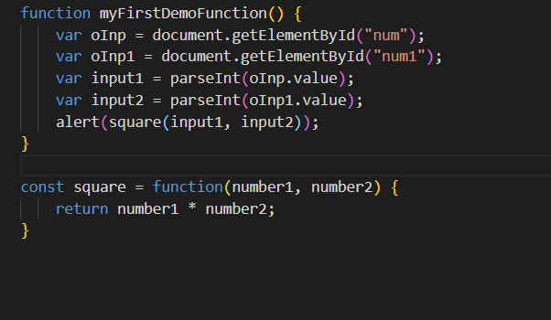
Functions with multiple parameters
A JavaScript function does not perform any checking on parameter values (arguments).
Function parameters are the names listed in the function definition.
If a function is called with missing arguments (less than declared), the missing values are set to undefined.
Syntax of function with multiple parameters
function functionName(parameter1, parameter2, parameter3) { // code to be executed }
Exercise code links for Multiple parameter
index.html
reuse.js
Trainer: Anubhav Oberoy

Slide 8
Synchronous and Asynchronous Response
User
Screen
Server
Database
Save
Processing
Time
Request send to server
Request to Database
Synchronous Response
For all this time user
Remains blocked
Response form Database
Save
Request send to server
For all this time user
Remains blocked
Request to Database
Asynchronous Response
For all this time user
Is Not Blocked
Response from the server
Response form Database

Slide 9
Array and Object in JS
Syntax for Array
var aItems = [item0, item1,….]
Syntax for object
var oObjName = { “prop”: value,
“prop”: value,
“prop”: value }
Example of an Object
{
//this is an EntitySet of type object (single)
"empStructure": {
"empNo": 100,
"empName": "Latika Roongta",
"salary": 9000,
"currency": "EUR"
}
}
Java Script Object Notation – JSON
You can validate json using https://jsonlint.com
Elements or properties
Entity set

Slide 10
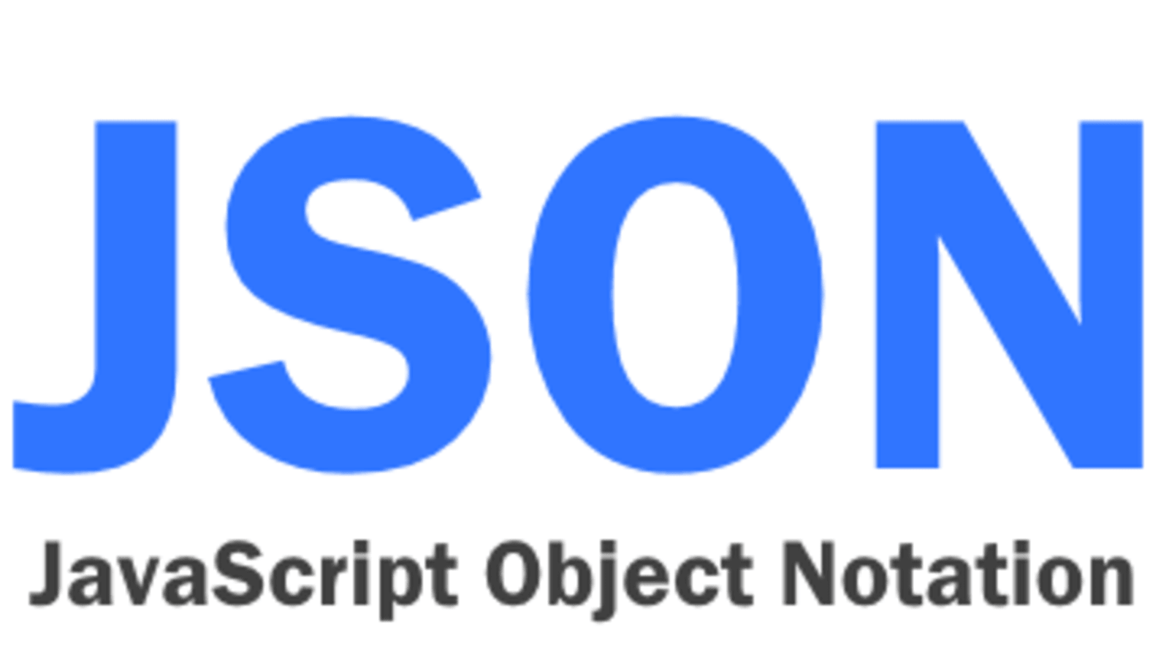
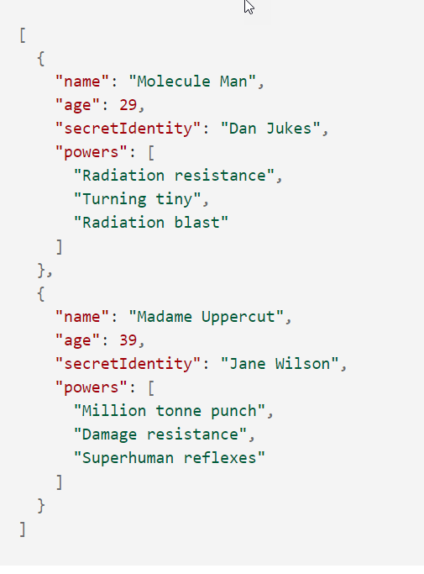
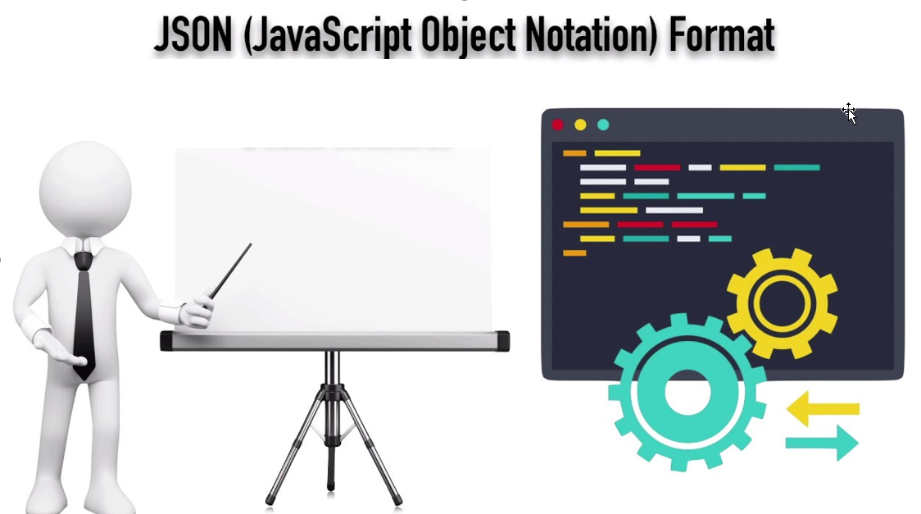
JavaScript Object Notation (JSON)
JavaScript Object Notation (JSON) is a standard text-based format for representing structured data based on JavaScript object syntax.JSON is a lightweight data-interchange format.
The JSON format is syntactically similar to the code for creating JavaScript objects. Because of this, a JavaScript program can easily convert JSON data into JavaScript objects.
JSON is purely a string with a specified data format — it contains only properties, no methods.
JSON requires double quotes to be used around strings and property names. Single quotes are not valid other than surrounding the entire JSON string.

Slide 11


Introduction to jQuery
jQuery is a java script library which is
It’s free to use
Used by top software companies like google, Netflix, etc.
Light weight JS library
jQuery greatly simplifies JavaScript programming.
Available on internet
Purpose is to write less and do more
Industry standard
Syntax:-
$(selector).action();
Selector:-
tagName, .className, #id
Exercise code link:
index.html
reuse.js

Slide 12

Why jQuery
It is incredibly popular, which is to say it has a large community of users and a healthy amount of contributors who participate as developers and evangelists.
It normalizes the differences between web browsers so that you don’t have to.
It is intentionally a lightweight footprint with a simple yet clever plugin architecture.
Its repository of plugins is vast and has seen steady growth since jQuery’s release.
Its API is fully documented, including inline code examples, which in the world of JavaScript libraries is a luxury. Heck, any documentation at all was a luxury for years.
It is friendly, which is to say it provides helpful ways to avoid conflicts with other JavaScript libraries.
It is a lot more easy to use compared to standard javascript and other javascript libraries.
jQuery lets users develop Ajax templates with ease, Ajax enables a sleeker interface where actions can be performed on pages without requiring the entire page to be reloaded.
Trainer: Anubhav Oberoy

Slide 13
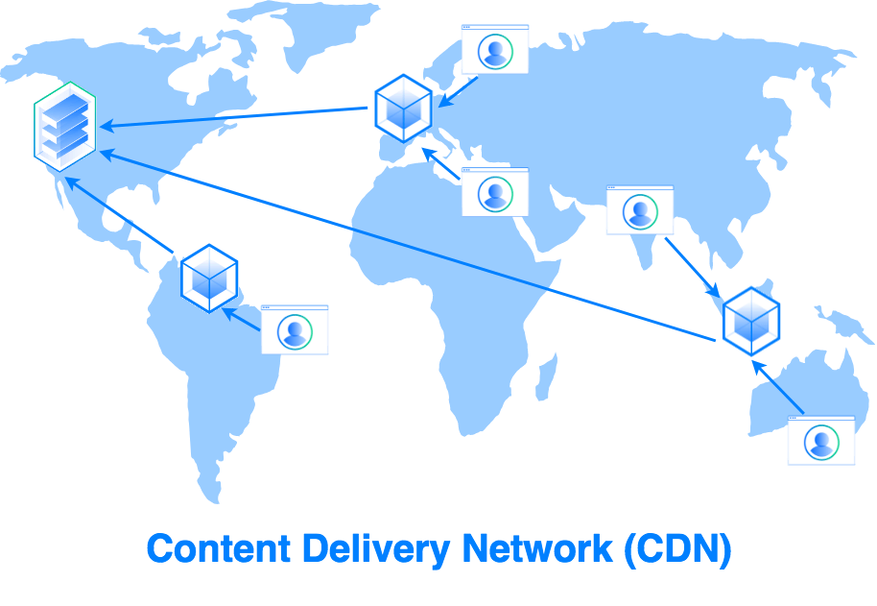
Content Delivery Network
A content delivery network (CDN) is a group of geographically distributed servers that speed up the delivery of web content by bringing it closer to where users are.
CDNs are a layer in the internet ecosystem.
Different loading time for users at different locations.
USA
Miami
Detroit
Mycode.js
Server
Mumbai
Mycode.js
India
Bangalore
Mumbai
Japan
Tokyo
Hongkong
Trainer: Anubhav Oberoy

Slide 14

End of Day 4

Slide 15

Questions

Slide 16

Anubhav Oberoy

Slide 17


We’re committed to empower you to be
Most Desirable Resource
through powerful training solutions.
We build the workforce of the future.
250+
Corporate Clients
30,000+
Learners Trained
25000+
Learners Placed
FREE WEBINARS
Sign up for free webinars with industry experts every fortnight!
Enroll Now!
Contact us today!
https://anubhavtrainings.com/

Slide 18




More from AnubhavTrainings.com

